Slide 1
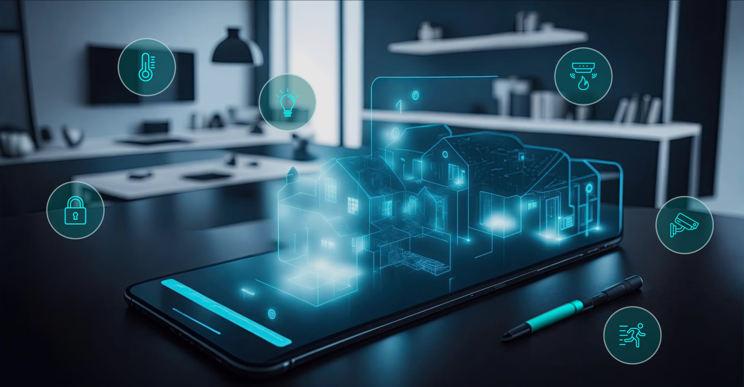

Team 61: Smart Home Automation
Bi-Weekly Update 3 Nick Tool, Tyler Mayou, Matthew McLean Sponsor: Souryendu Das TA: Fahrettin Ay
Notes:
Michelle

Slide 2
Project Summary
The Problem: “Smart home systems are often composed of many different components from different companies. This can make it very difficult for a user to combine devices and implement a fully functional system for their own personal living or working space.”
Our Goal: “Develop a basic smart home automation system that allows users to control a few essential home appliances (like lights and speakers) via a mobile app and a simple web interface. The system will use IoT/non-IoT devices and a local server and online database.”
Notes:
Kyle

Slide 3
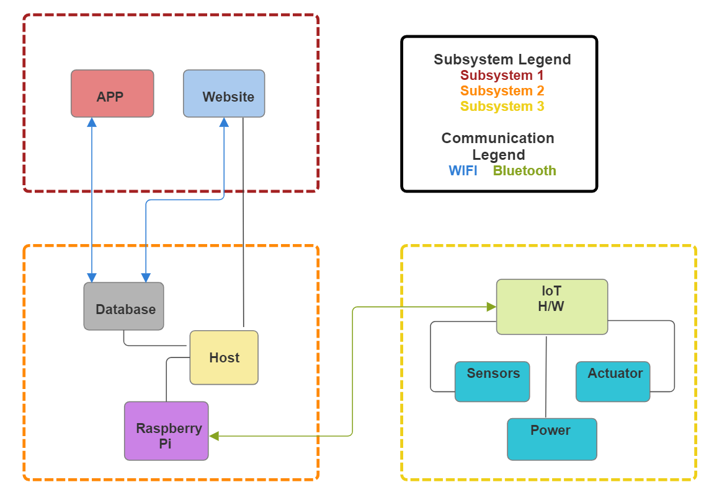
Project/Subsystem Overview
Matthew McLean
MQTT
Tyler Mayou
Nick Tool
Notes:
Eric

Slide 4
Project Timeline
Green done, Yellow underway, White not started
Subsystem Designs and Testing (to complete 2/10) | Integration of App and Website (to complete 2/24) | Integration of IoT Hardware (to complete by 3/10) | Final Integration (to complete by 3/17) | System Test (to complete by 3/24) | Validation (to complete by 4/7) | Demo and Report (to complete by 4/21)
Notes:
Eric

Slide 5
Web and Mobile App
Matthew McLean
Accomplishments since last update 15 hrs of effort | Ongoing progress/problems and plans until the next presentation
Continued work on improving app designs Updated settings page and device selection | Continue Integrating with Backend Should be able to create new user and store device names in database

Slide 6
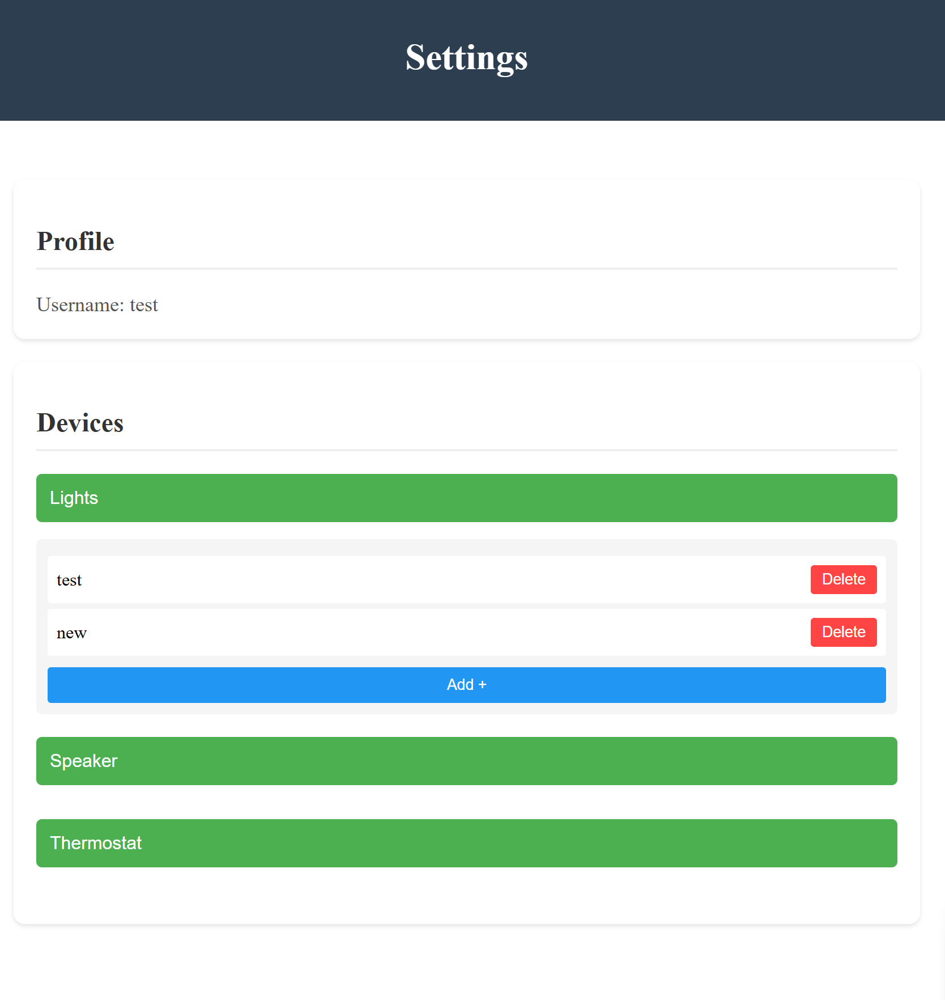
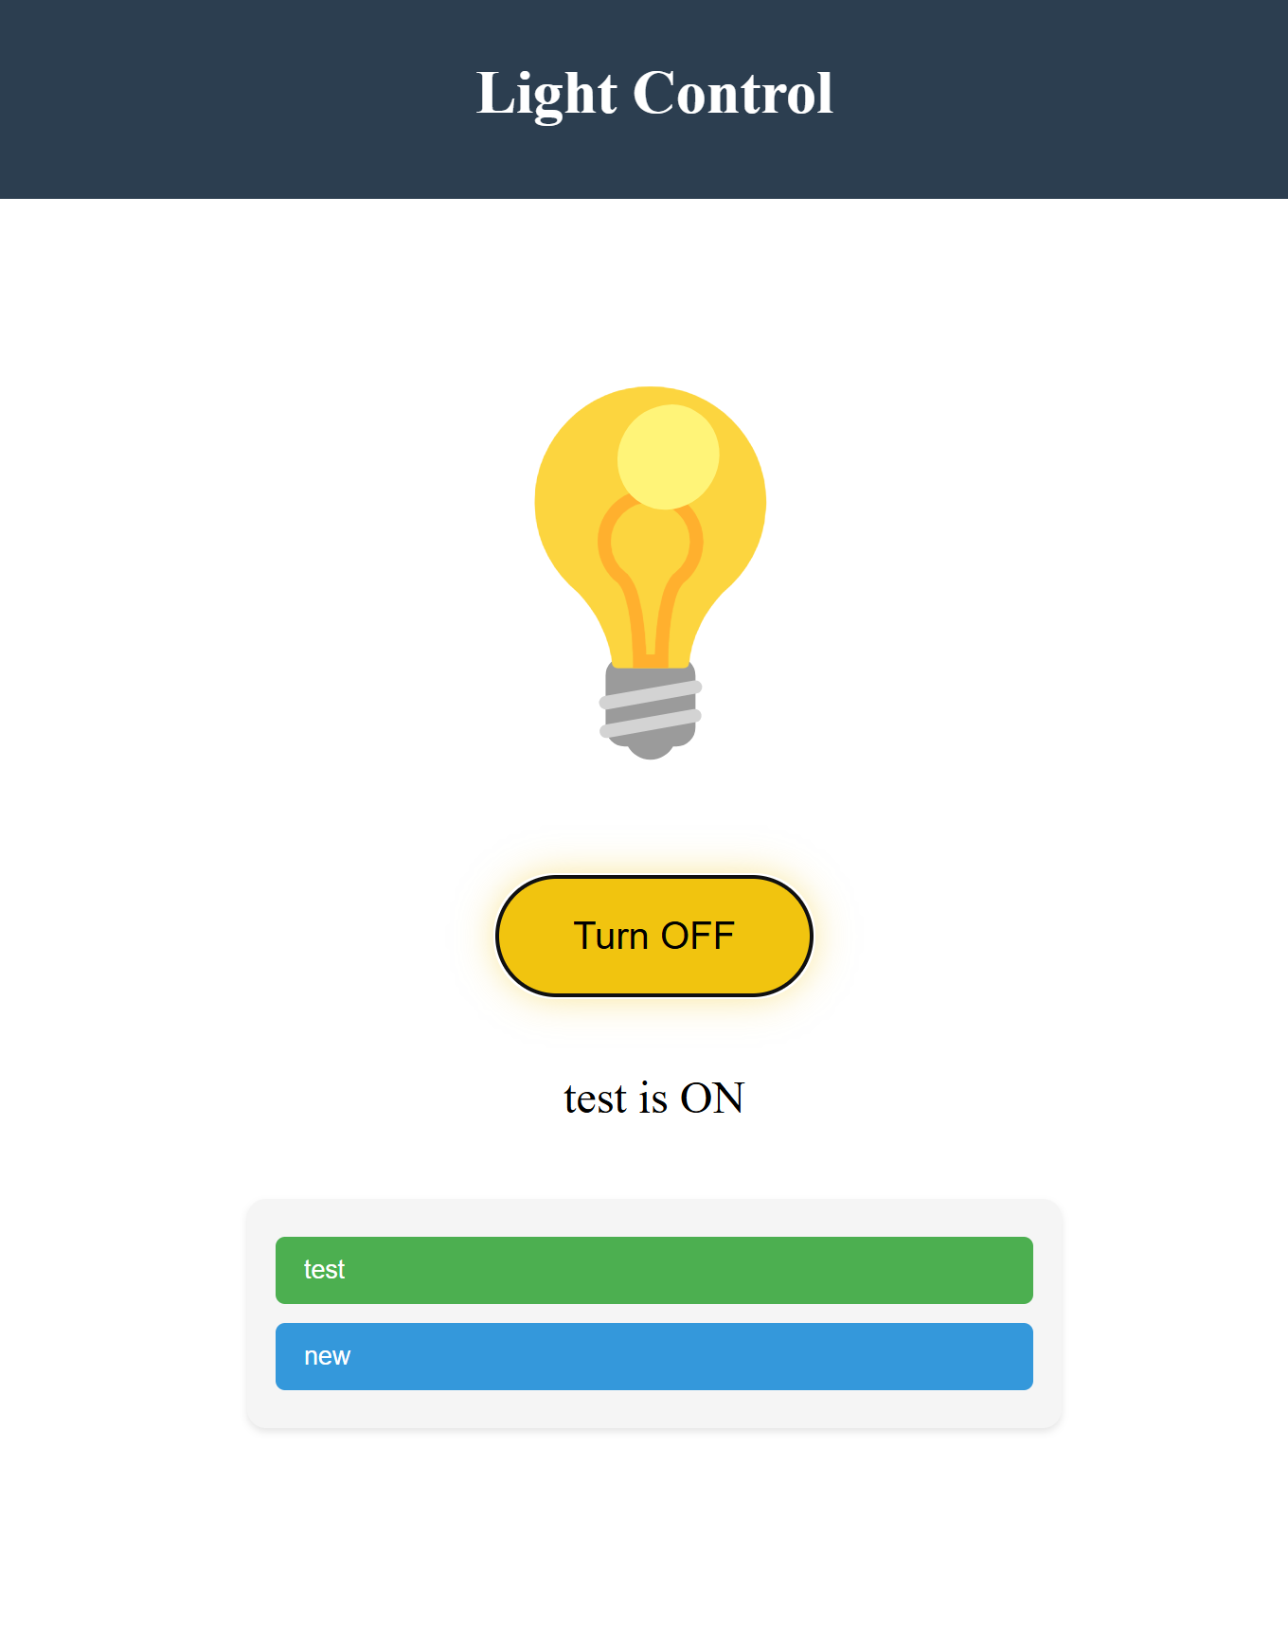
Web and Mobile App
Matthew McLean

Slide 7
IoT Hardware
Tyler Mayou
Accomplishments since last update 10 hrs of effort | Ongoing progress/problems and plans until the next presentation
Subsystem works as it did in 403 on new PCB | Fix issues with the AC module and light bulb Begin integrating with Host and Database using MQTT over TCP integration Test Power to Raspberry PI

Slide 8
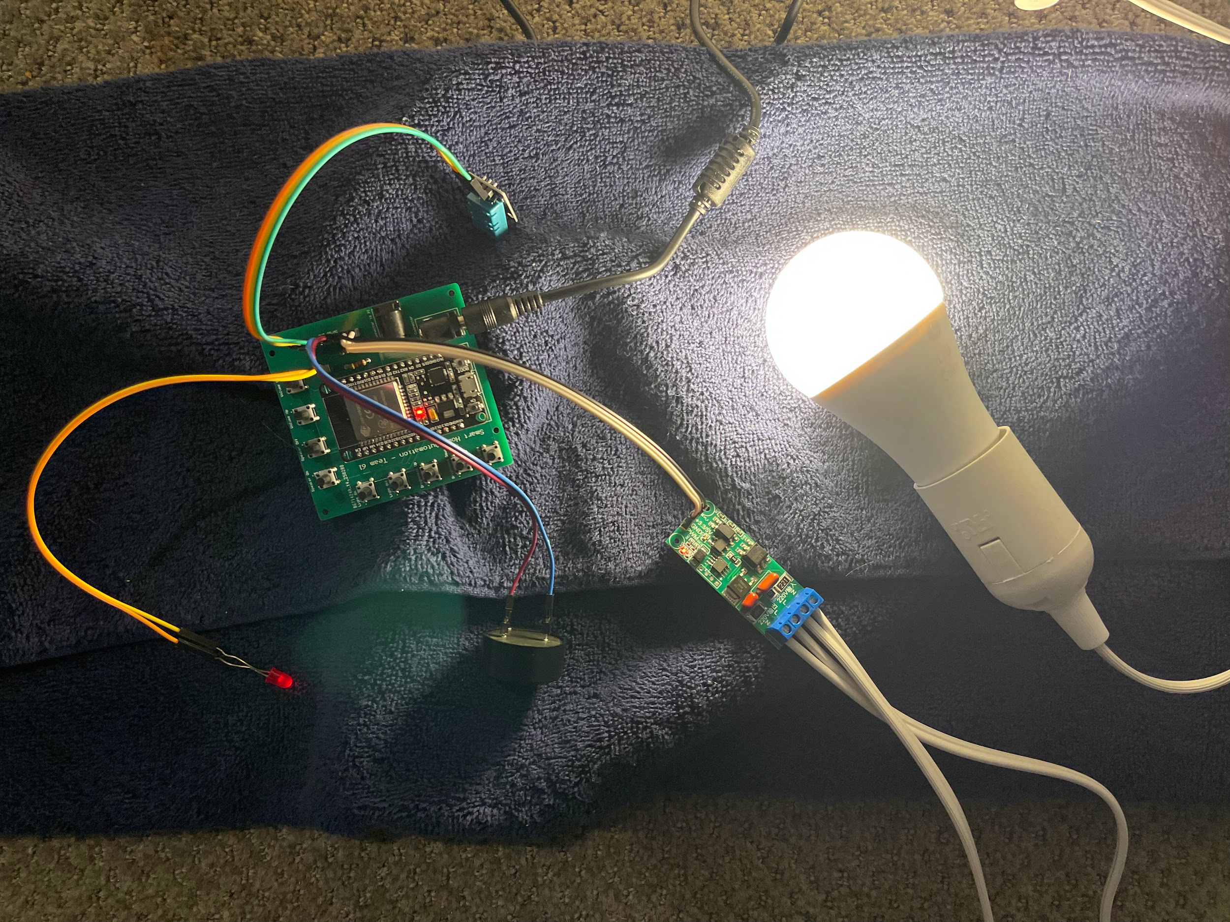
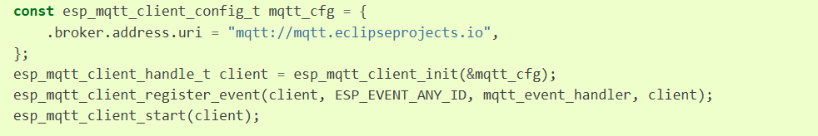
IoT Hardware
Tyler Mayou
Espressif API Reference:
https://docs.espressif.com/projects/esp-idf/en/stable/esp32/api-reference/protocols/mqtt.html

Slide 9
Database and Local Host
Nick Tool
Accomplishments since last update 15 hrs of effort | Ongoing progress/problems and plans until the next presentation
Fixed issue with JSON payloads being malformed Ongoing Integration between front-end and back-end Integration testing through website & database | Finish full integration of front and backend Begin to work on hardware integration & MQTT integration

Slide 10
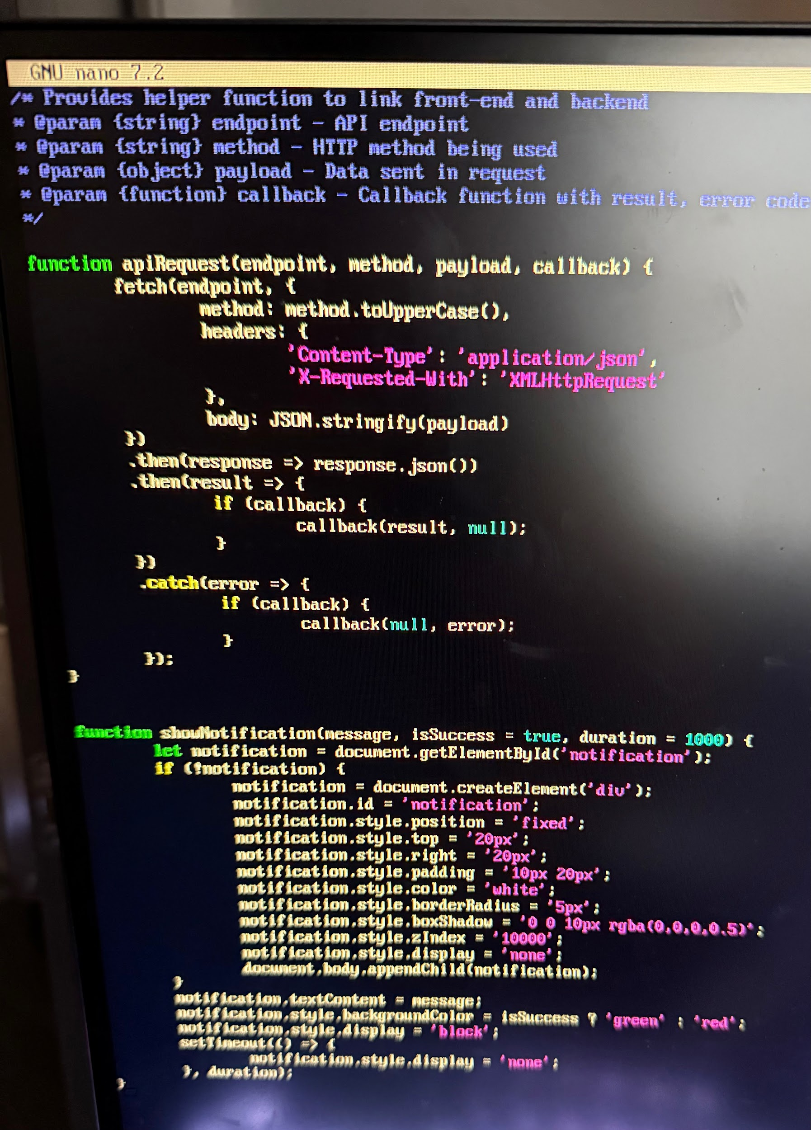
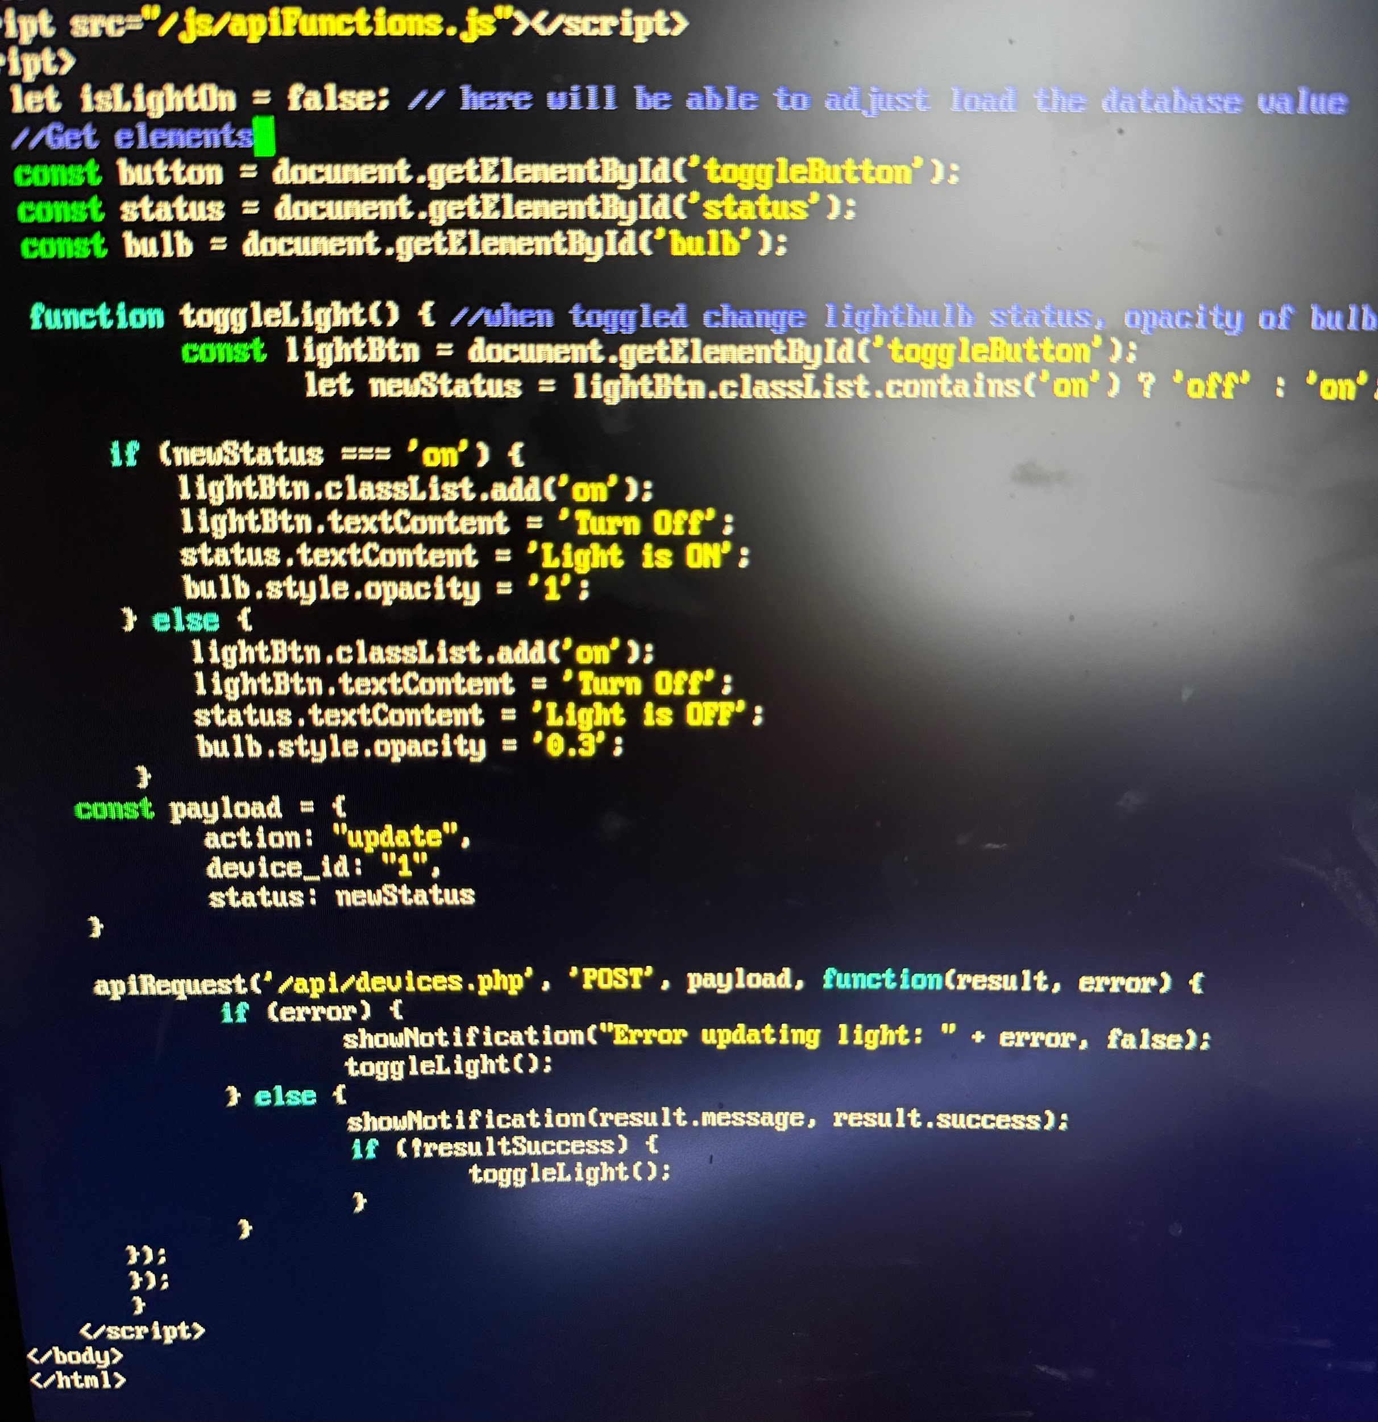
Database and Local Host
Nick Tool

Slide 11
Execution & Validation Plan
 | 1/20 | 1/27 | 2/3 | 2/10 | 2/17 | 2/24 | 3/3 | 3/10 | 3/17 | 3/24 | 3/31 | 4/7 | 4/14 | 4/21 | 4/28 | Legend
Matthew McLean |  |  |  |  |  |  |  |  |  |  |  |  |  |  |  | Finished
Update Layout Of Website |  |  |  |  |  |  |  |  |  |  |  |  |  |  |  | Working on it
Integrate System with Host Server |  |  |  |  |  |  |  |  |  |  |  |  |  |  |  | Haven’t Started
Integrate Entire System
Nick Tool
Implement Public IP address
Implement Security Features
Integrate Host System with Mobile App and Website
Integrate Host System with IoT Hardware
Validate App & Website Integration
Validate IoT Hardware Integration
Test and Validate Basic Functions in Fully Integrated System
Test Edge Cases in Fully Integrated System
Tyler Mayou
Discuss 404 modifications
Order parts for modification
Order NEW PCB
Hardware integration
Team
Update #2
Update #3
Update #4
Update #5
Final Presentation
Final Demo
Final Report
Integration
System Test
Validation
Notes:
Michelle

Slide 12
Thanks and Gig ‘Em

